Slide 1
Vision Diagrams Series Microsoft Priva
Thierry Matusiak - Data Protection & Compliance - Technical Specialist
Version : 2022-08-11

Slide 2
Microsoft Priva
fulfills data subject requests
and monitors personal data
Priva – Definition

Slide 3
Priva is made of 2 modules
Risk Management Policies
Subject Rights Requests
blocks
messages in
Teams
sends email
Users
officers
Teams
Administrators
notifications to
collaborate in
define privacy policies
officers launch
Priva
actions with
Power Automate
Context
Data Subjects
request access to
their personal data
Priva
DSR Results
officers export
Administrators
manage DSRs
identifies and
extracts data in
M365

Slide 4
Priva
Data Subject Request Administrator
Privacy Management Administrator
Viewers
Case Analyst
Data Subject
Organization
Policies
generate
Alerts
confirmed
Issues
Requests
Data Profile
into
by locations
by data type
by countries
Data
explore
Content
Subject
data in
Explorer
Summary
Scope
Search Settings
Overexposure
Policies
review
Data collected
Conditions
Files & Messages
Minimization
Policies
generate
Reports
Transfer
Matched
Policies
Items

Slide 5
Anonymisation for User privacy
Priva
Settings
User notifications
Personal data : schema + upload
Data subject request retention period
Data review tags (system + custom)
Data Subject Request Administrator
Privacy Management Administrator
Viewers
Case Analyst
Data Subject
Access / Export
Organization
Policies
generate
Alerts
confirmed
Issues
Requests
Related regulations (GDPR, CCPA)
Data Profile
into
Deadline
Request notes
by locations
Teams Policy tips
Severity
by data type
Email Notifications to users
Case notes
Name
by countries
Alerts to admins
Data
Email
explore
Content
Test mode (ON/OFF)
Case Investigator
Subject
Residency
data in
Explorer
Sensitive Info types
Link (customer, employee)
Scope
Data classification groups
Content
Users
Personal attributes : address, ID, birthdate, phone number...
Locations
Search Settings
Conditions : timeframe, retention labels, participants, subject
More Details
Overexposure
Locations
Collaborators
Policies
review
Data collected
Tags
Conditions
Access Levels
Files & Messages
Content redaction
Minimization
File notes
Policies
generate
Internal reports
Last modification date
Reports
Final report for the data subject
Transfer
Matched
Policies
Items
Between departments
Collaborators
Request Contributor
Across regions
Data estimate
Item
Retrieve data
Content
Progress
Review data
Generate reports
Close the request
collaborate
Teams
API
Namespace : microsoft.graph
https://docs.microsoft.com/en
-
us/graph/api/resources/subjectrightsrequest
-
subjectrightsrequestapioverview?view=graph
-
rest
-
1.0
launch
Power Automate
actions

Slide 6
Vision Diagrams Series Microsoft Priva
Thierry Matusiak - Data Protection & Compliance - Technical Specialist

Slide 7

Conclusion

Slide 8
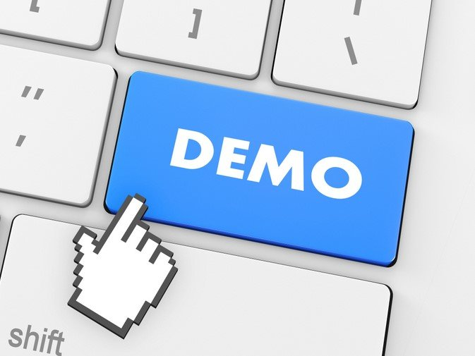

Slide 9
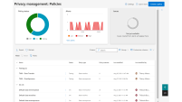
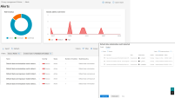
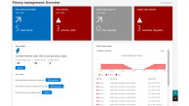
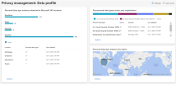


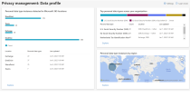
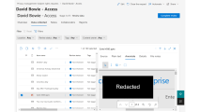
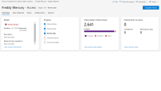
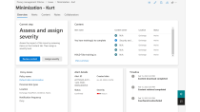




Priva
Data Subject Request Administrator
Privacy Management Administrator
Viewers
Case Analyst
Data Subject
Organization
Policies
generate
Alerts
confirmed
Issues
Requests
Data Profile
into
by locations
by data type
by countries
Data
explore
Content
Subject
data in
Explorer
Priva – Screenshots
Scope
Search Settings
Overexposure
Policies
review
Data collected
Conditions
Files & Messages
Minimization
Policies
generate
Reports
Transfer
Matched
Policies
Items

Slide 10
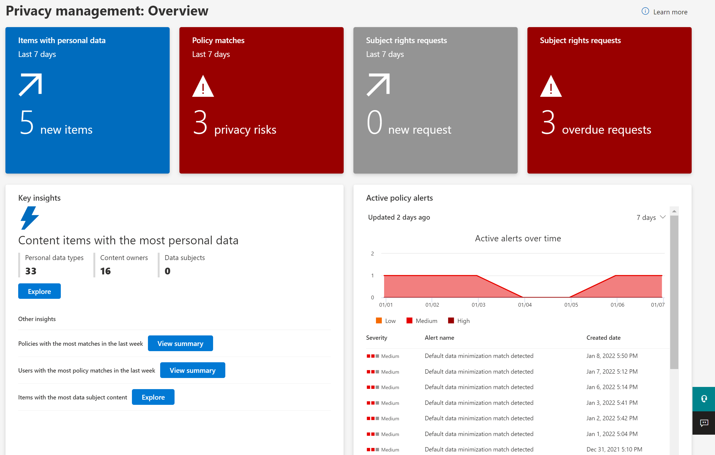

Slide 11
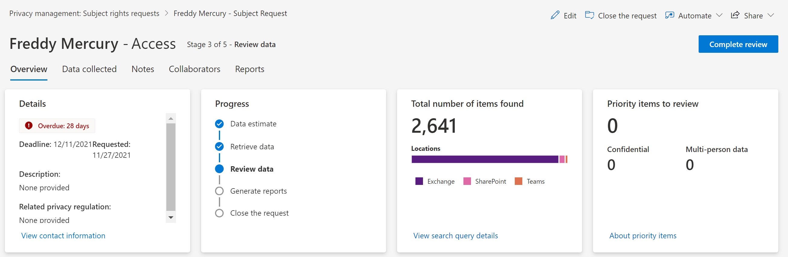

Slide 12
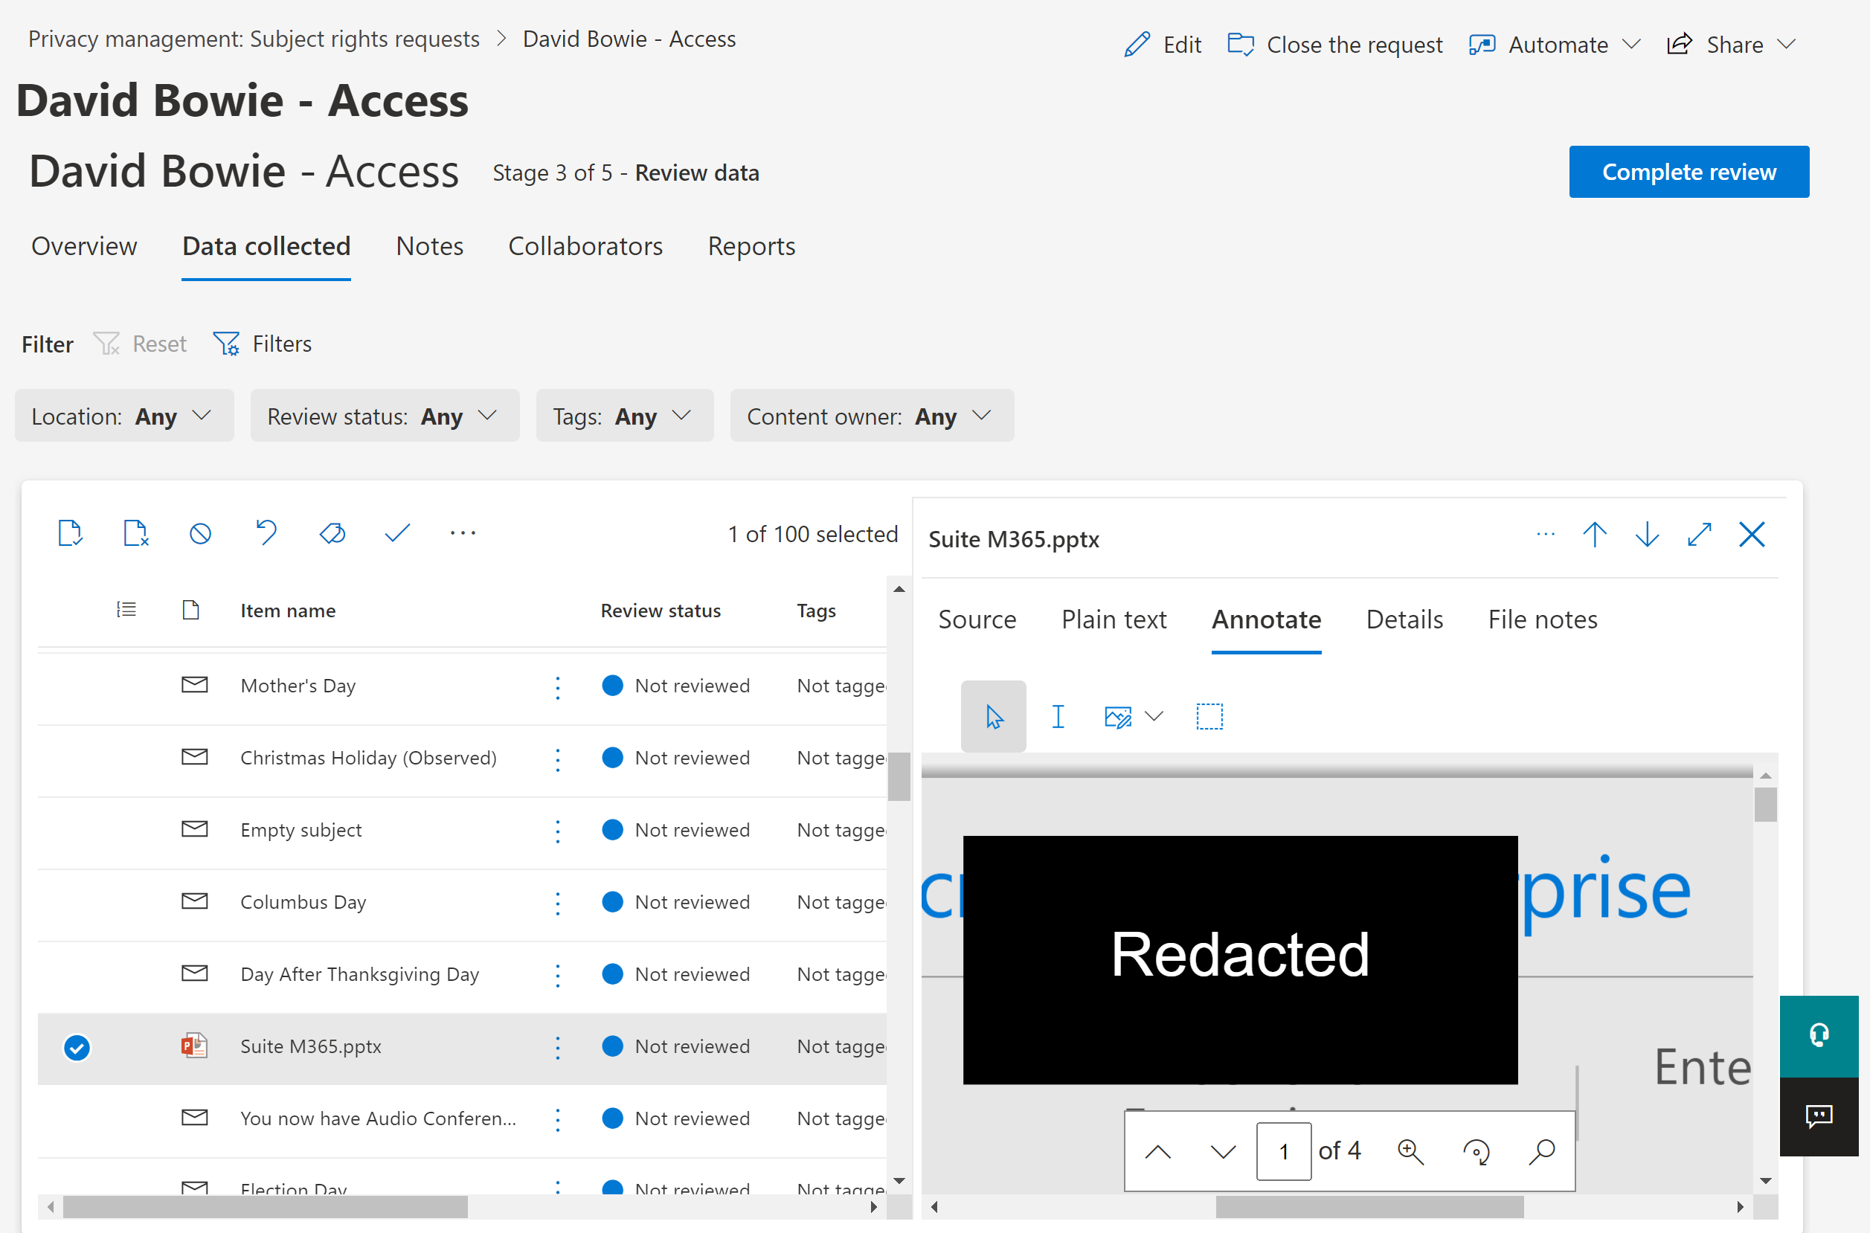

Slide 13
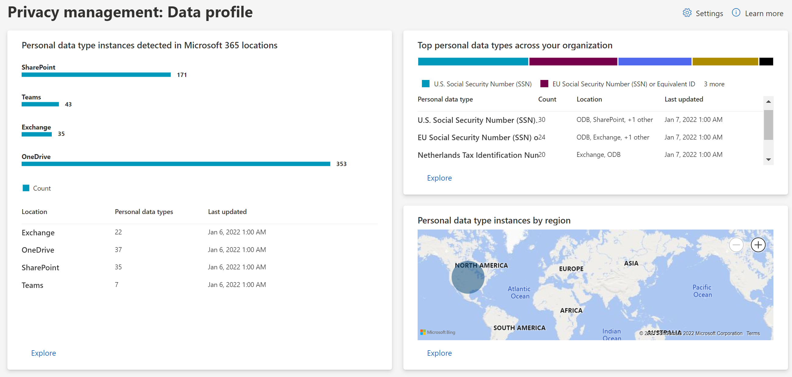

Slide 14
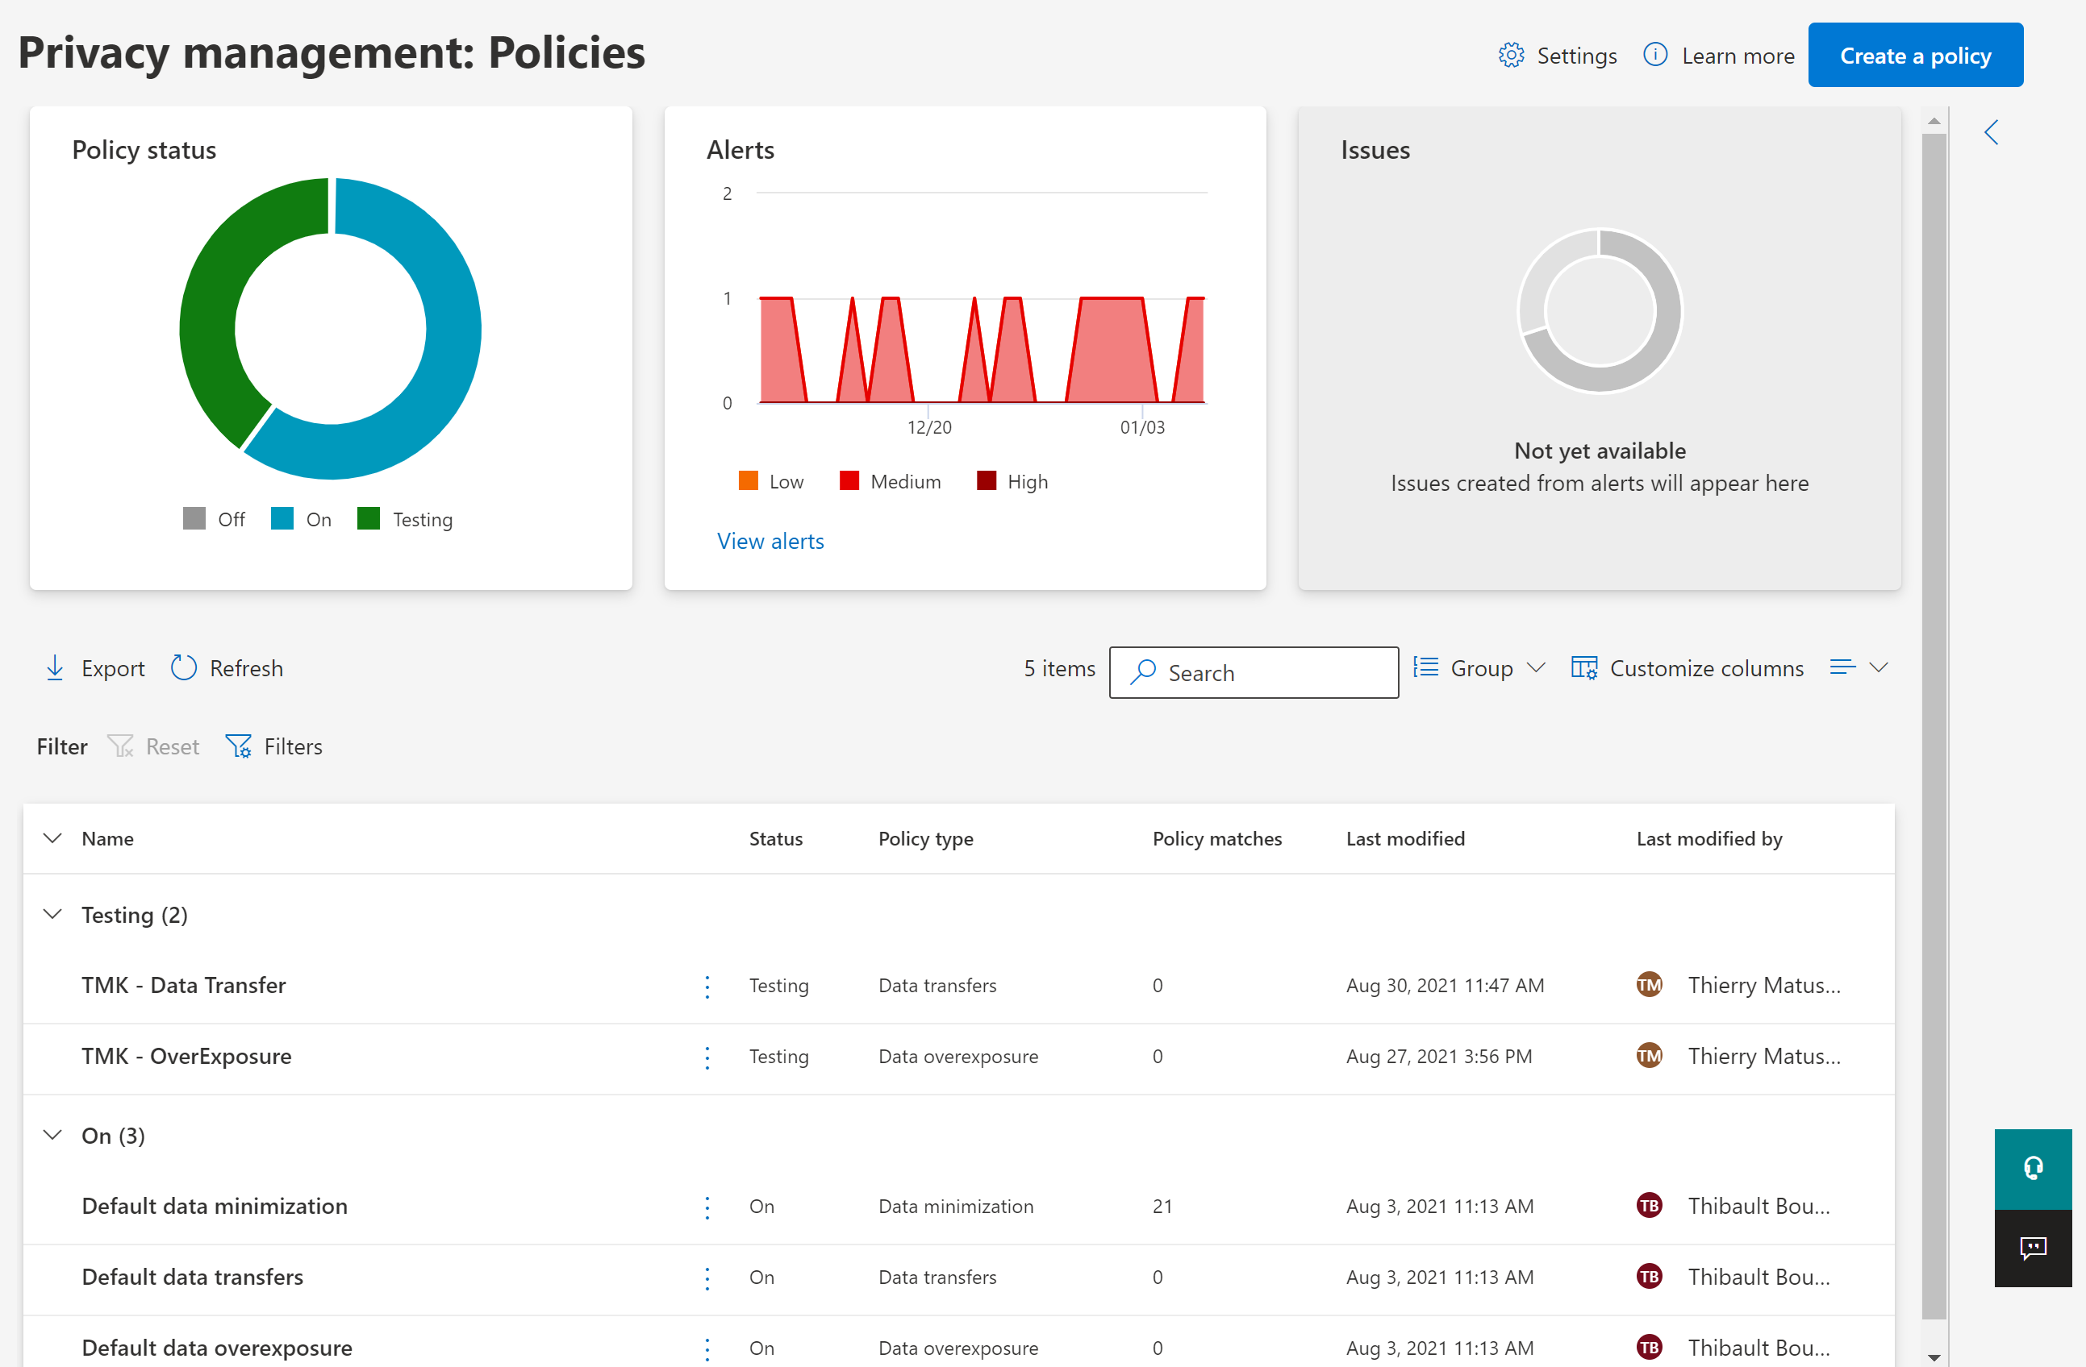

Slide 15
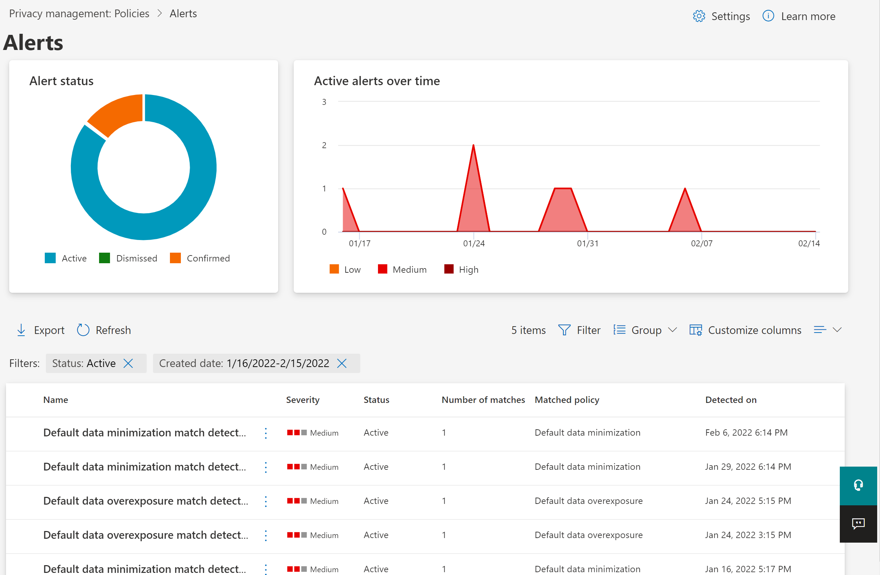
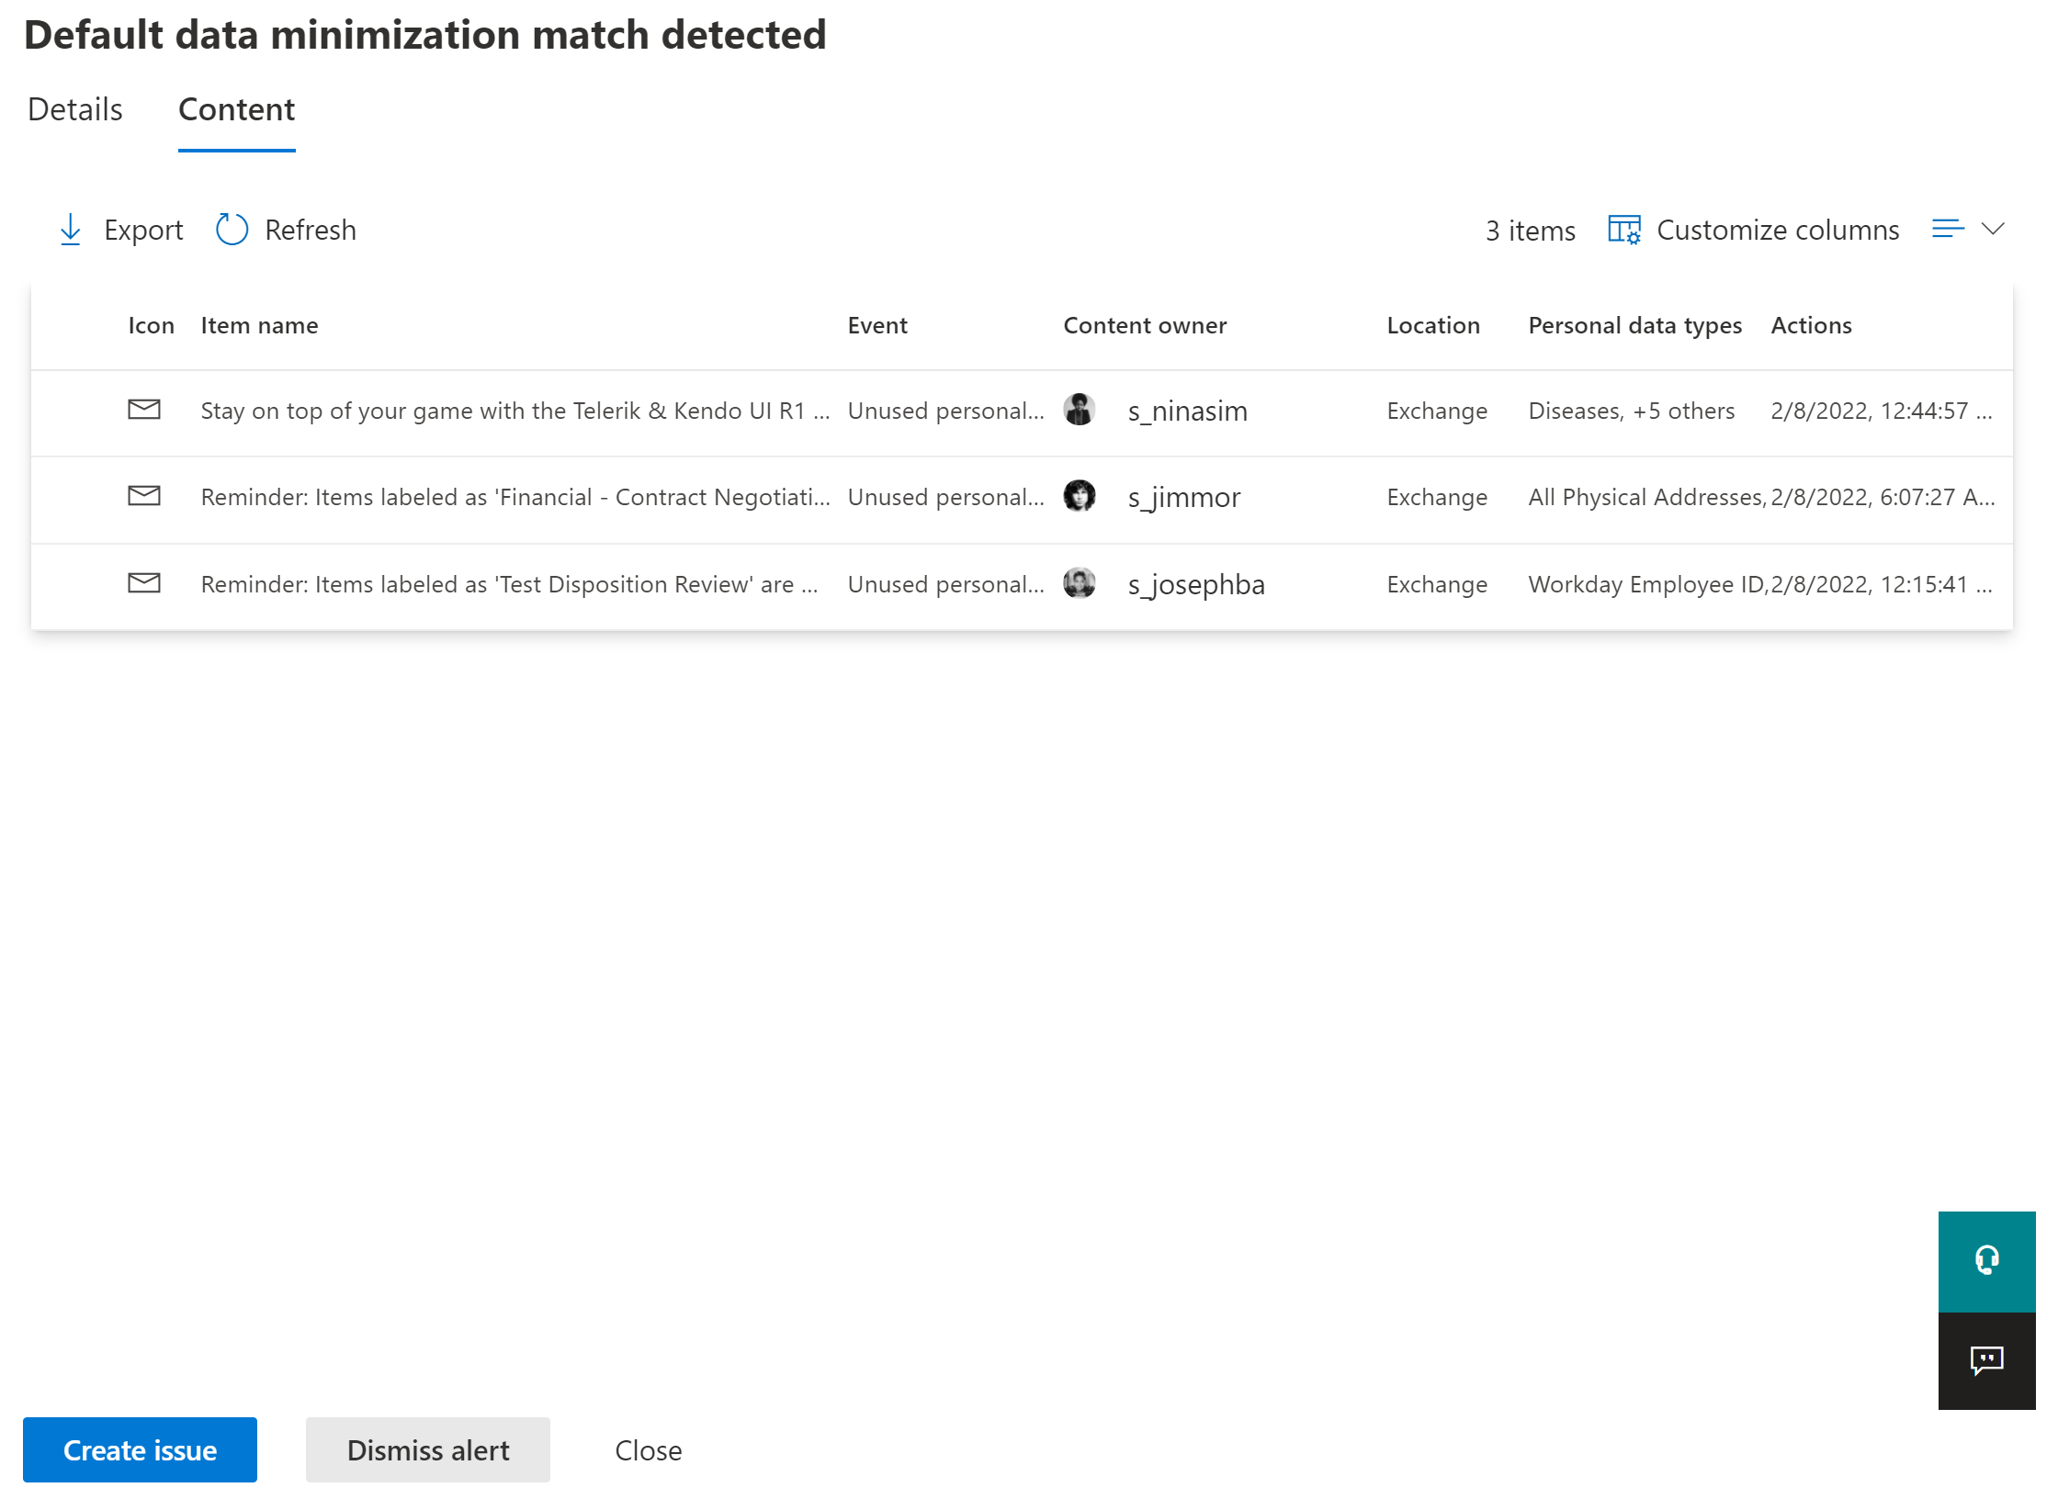

Slide 16
